Slide 1


Slide 2
Rendition of App screen to Desktop (Set 2)

Slide 3

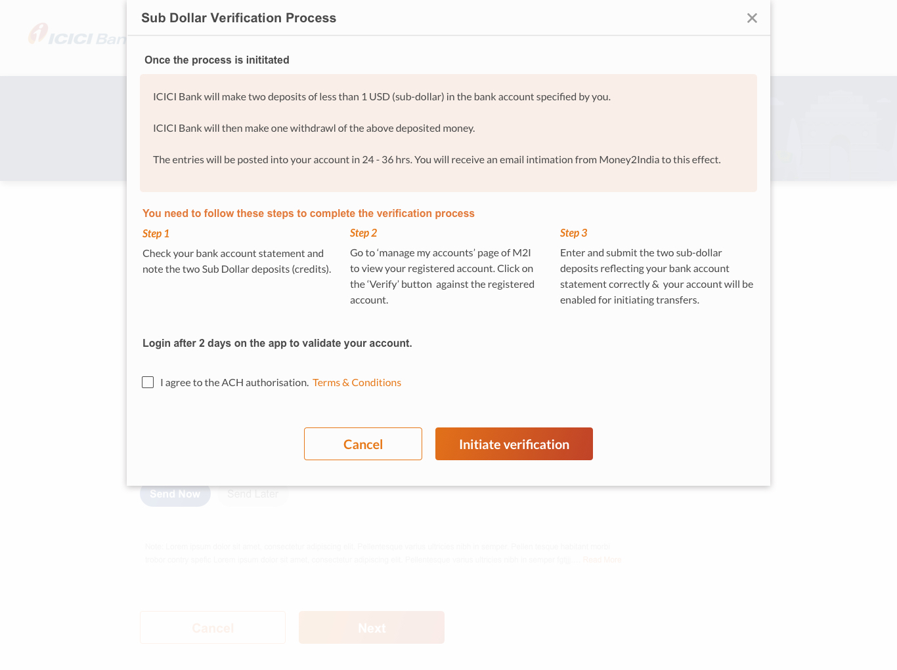
Notice/message Screen
App
Desktop

Slide 4
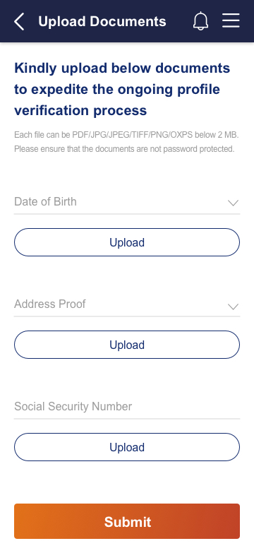
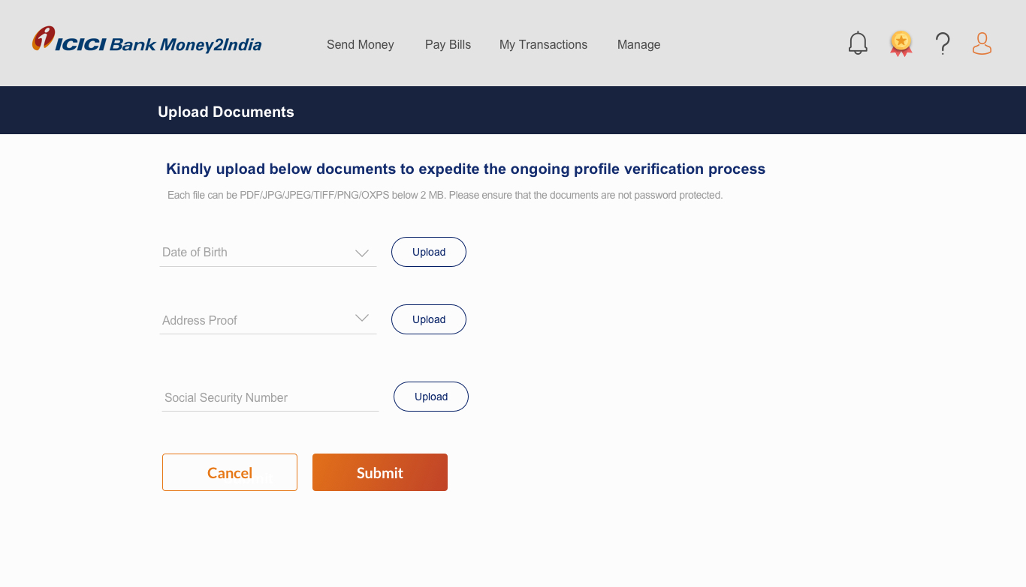
Upload Screen
App
Desktop

Slide 5
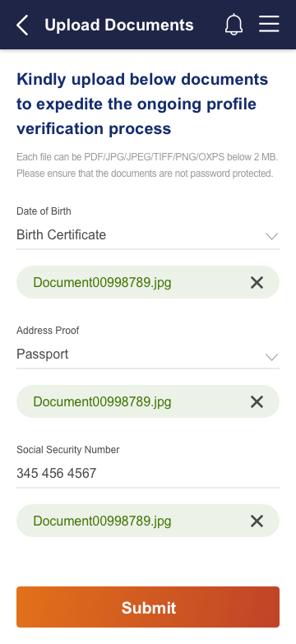
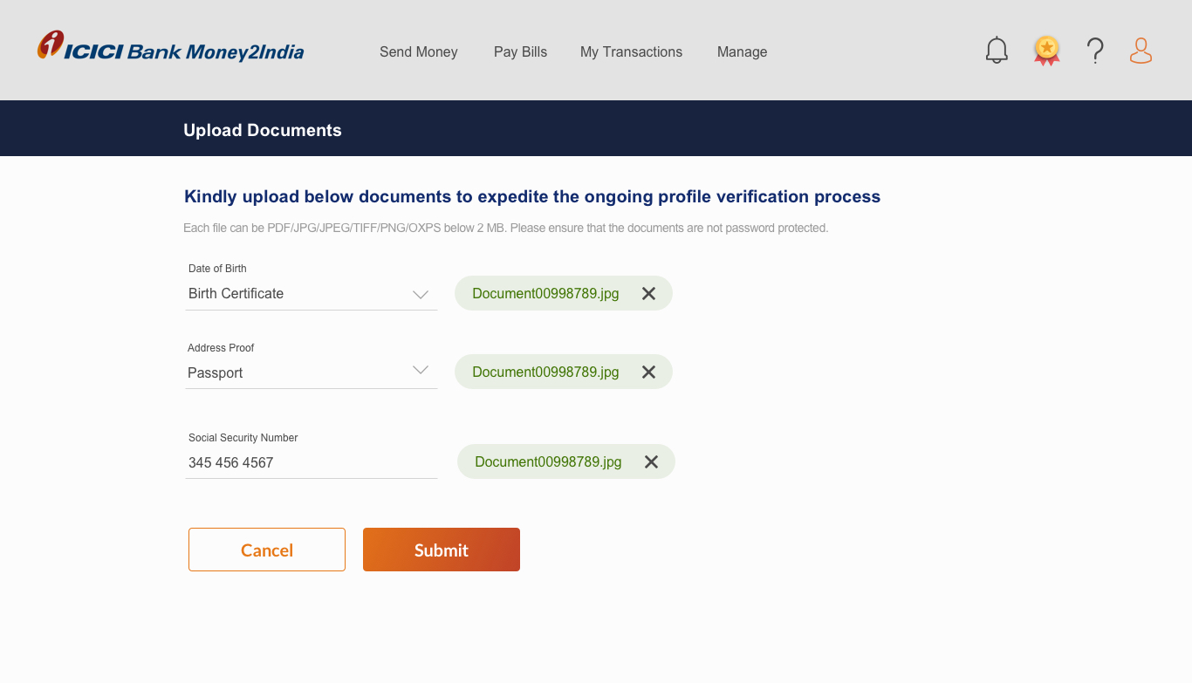
Upload Screen
App
Desktop

Slide 6
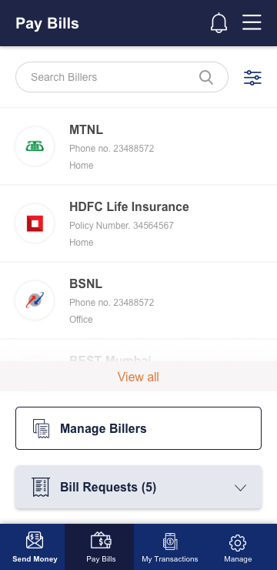
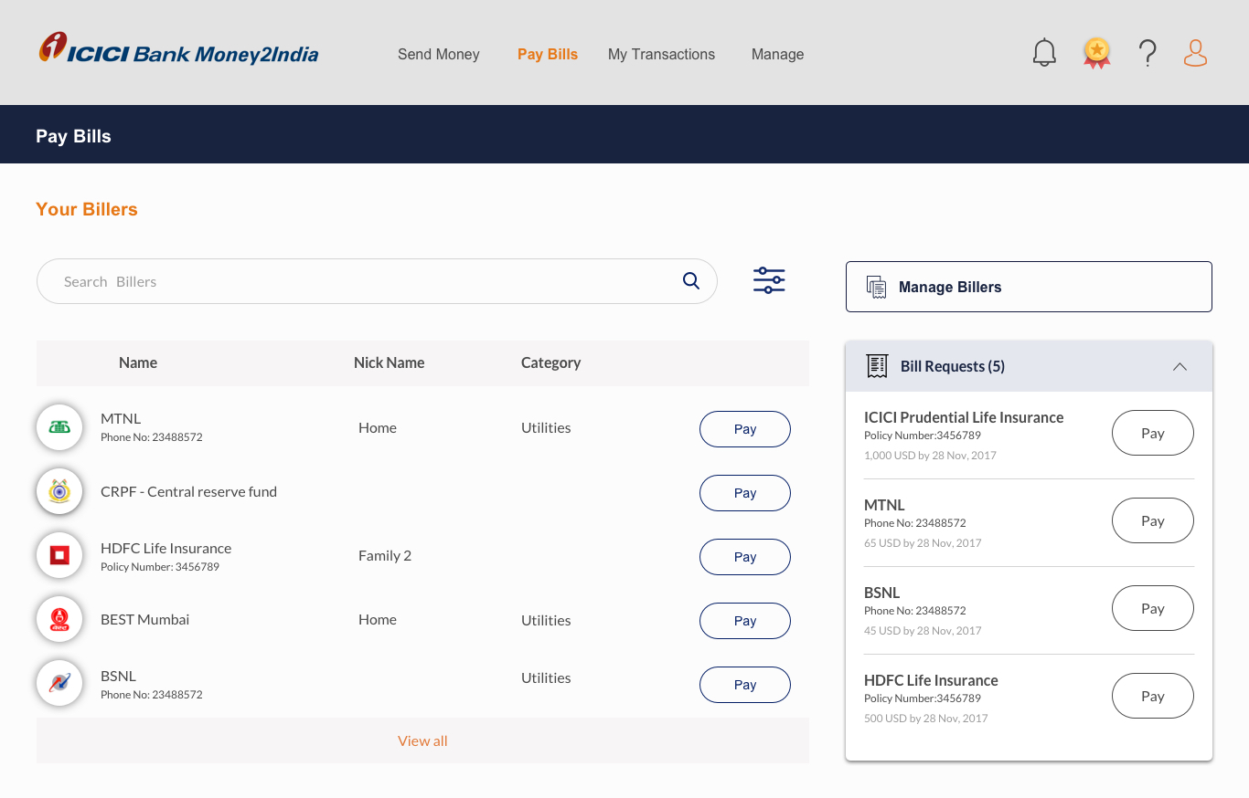
Pay Bills Screen
App
Desktop

Slide 7
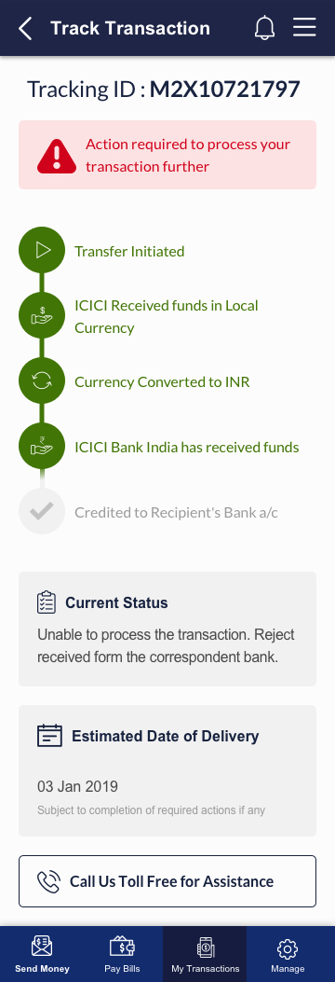
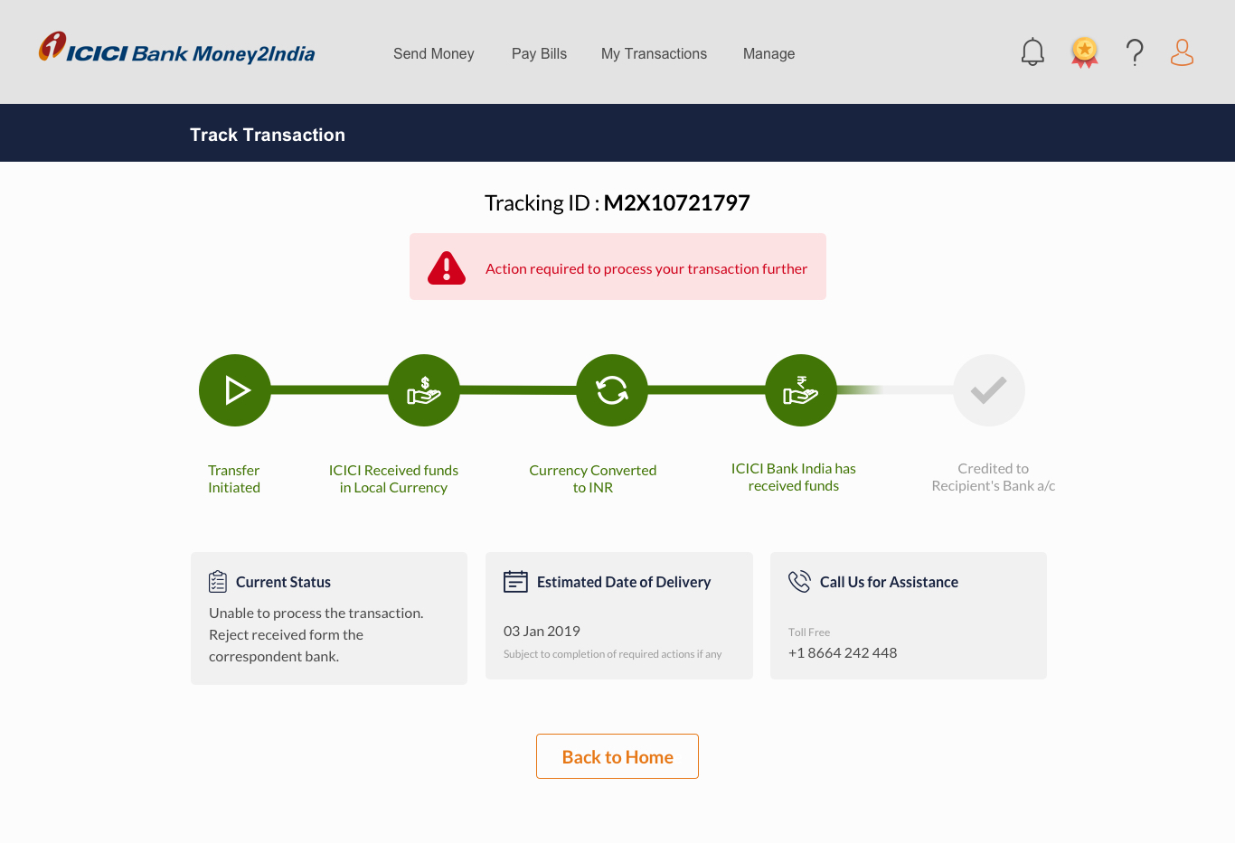
Tracking Screen
App
Desktop

